Slide 1
Pre Calculus 12 Section 2.1 Graphing Radical Functions
© Copyright all rights reserved to Homework depot: www.BCMath.ca

Slide 2
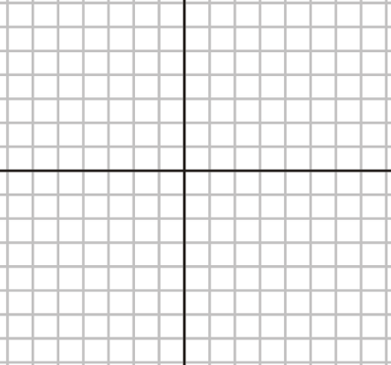
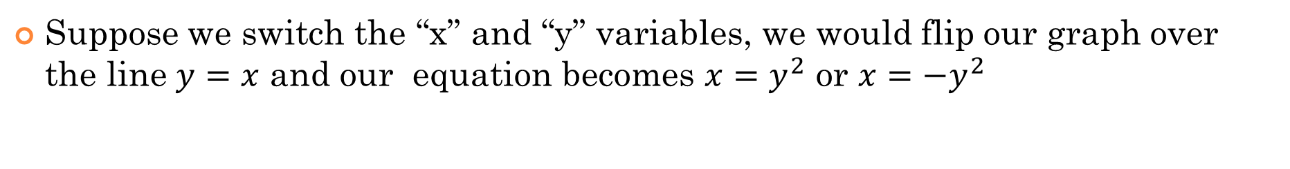
Review: parabolas and Inverse Functions
The graph of $y=x^{2}$ is a parabola that opens up:
The graph of $y={−x}^{2}$ is a parabola that opens down:
Suppose we switch the “x” and “y” variables, we would flip our graph over the line $y=x$ and our equation becomes $x=y^{2}$ or $x={−y}^{2}$

Slide 3
I)Understanding Root Functions:
A root function is similar to a parabola on it’s side
Suppose you are to graph
You get a horizontal parabola
If you square root the original equation:
y
6
The top half of the root function will be:
4
Opens UP
2
x
-2
0
2
4
6
8
The bottom half of the root function will be:
-2
Opens Down
-4
These two graphs are two SEPARATE functions!
-6

Slide 4
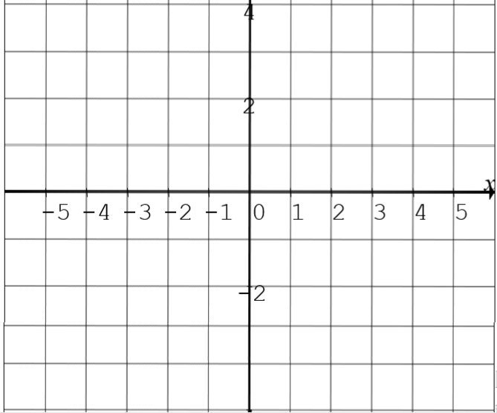
Radical Functions and General Directions:
In this section, we will look at how a radical function is affected graphically when certain transformations are applied to it
Let’s begin by looking at the general direction of a radical function when negative signs are applied:
Radical Opens UP and towards the RIGHT!
Radical Opens DOWN and towards the RIGHT!
Radical Opens UP and towards the LEFT!
Radical Opens DOWN and towards the LEFT!
y
y
4
4
2
2
x
x
-5
-4
-3
-2
-1
0
1
2
3
4
5
-5
-4
-3
-2
-1
0
1
2
3
4
5
-2
-2

Slide 5
Transformations with Radicals:
“A” Vertical Expansion or Compression: CEEC A – positive : opens up - negative : opens down
“B” Horizontal Expansion or Compression: CEEC
B – positive : Opens Right - negative : Opens LEFT
“C” Horizontal Translation: LEFT or RIGHT
“D” Vertical Translation: UP or DOWN

Slide 6
Given the following radical functions, indicate the values of “A” “B” “C” and “D”, which ways the graph opens, domain and Range

Slide 7
How to Graph a Radical Function:
First determine which way the graph opens, UP/DOWN and LEFT/RIGHT
“A” positive – opens UP “A” negative – opens DOWN
“B” positive – opens RIGHT “B” negative – opens LEFT
Find “C” and “D” to determine the shift of the graph → a new center
Shift your “x” and “y” axis to determine where your graph start
Pick some points to graph near the “new” center
Pick some nice values for “x’ and then solve for “y”

Slide 8
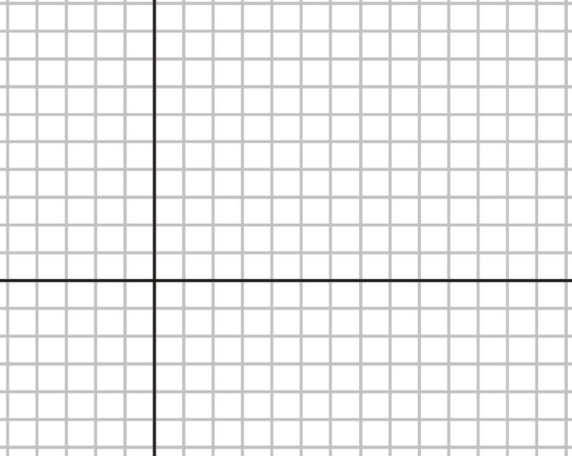
EX: Graph the following functions
The intersection of the new “x” and “y” axis will be where the radical functions starts!
First factor the inside of the function:
Pick some points!!
Since “A” is positive, the graph will open UP!
Since “B” is positive, the graph will open to the RIGHT!
Draw your new “Y” axis 4 units to the right
Draw your new “X” axis 2 units down

Slide 9
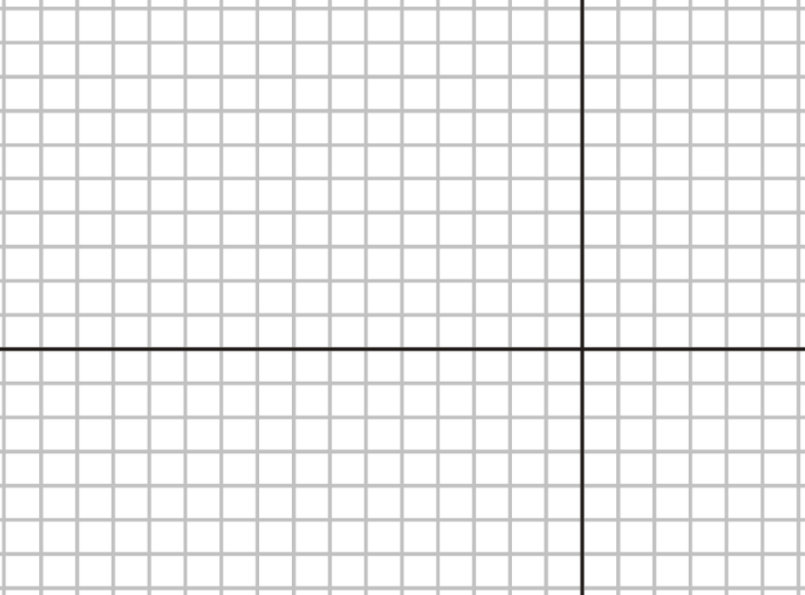
Practice: Graph the following functions
The intersection of the new “x” and “y” axis will be where the radical functions starts!
Pick some points that are to the left of the new center
Since “A” is negative, the graph will open DOWN!
Since “B” is negative, the graph will open to the LEFT!
Draw your new “Y” axis 3 units to the right
Draw your new “X” axis 4 units up

Slide 10
Graph the following Functions:

Slide 11
Practice: Graph the following functions
The intersection of the new “x” and “y” axis will be where the radical functions starts!
Pick some points that are to the right of the new center
Since “A” is negative, the graph will open DOWN!
Since “B” is positive, the graph will open to the RIGHT!
Draw your new “Y” axis 4.5 units to the left
Draw your new “X” axis 7 units up

Slide 12
Practice: Graph the following functions
The intersection of the new “x” and “y” axis will be where the radical functions starts!
Pick some points that are to the left of the new center
Since “A” is positive, the graph will open UP!
Since “B” is negative, the graph will open to the LEFT!
Draw your new “Y” axis 2.5 units to the right
Draw your new “X” axis 4 units down

Slide 13
Practice: Graph the following functions
The intersection of the new “x” and “y” axis will be where the radical functions starts!
Pick some points that are to the left of the new center
Since “A” is negative, the graph will open DOWN!
Since “B” is negative, the graph will open to the LEFT!
Draw your new “Y” axis 4 units to the left
Draw your new “X” axis 2 units up

Slide 14
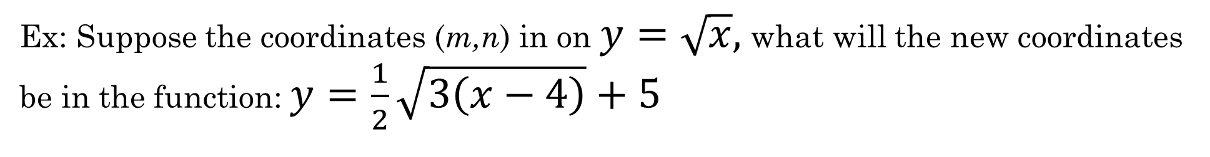
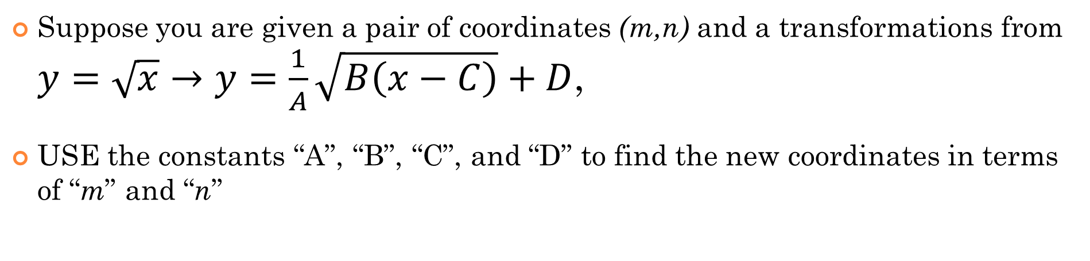
Mapping Coordinates for Radical Functions:
Suppose you are given a pair of coordinates (m,n) and a transformations from $y=\sqrt{x}→y=\frac{1}{A}\sqrt{B\left(x−C\right)}+D$,
USE the constants “A”, “B”, “C”, and “D” to find the new coordinates in terms of “m” and “n”
Ex: Suppose the coordinates (m,n) in on $y=\sqrt{x},$what will the new coordinates be in the function: $y=\frac{1}{2}\sqrt{3\left(x−4\right)}+5$

Slide 15
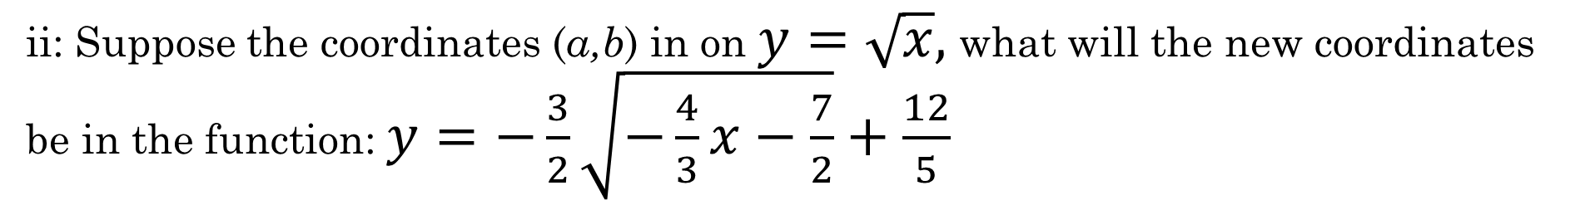
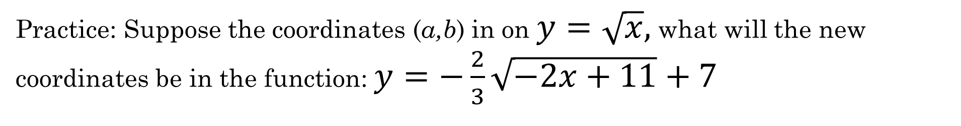
Practice: Suppose the coordinates (a,b) in on $y=\sqrt{x},$what will the new coordinates be in the function: $y=−\frac{2}{3}\sqrt{−2x+11}+7$
ii: Suppose the coordinates (a,b) in on $y=\sqrt{x},$what will the new coordinates be in the function: $y=−\frac{3}{2}\sqrt{−\frac{4}{3}x−\frac{7}{2}}+\frac{12}{5}$

